Slide 1
Presentation of the CBF-SEA Sub region
Dr. Natividad B. Pagadut
CBF-SEA Coordinator

Slide 2
Introduction

Slide 3
The Constitution, as amended during the Bogotá Plenary Assembly officially recognizes the structuring of regions and sub-regions (Art. IX) and defined the roles of regional and sub-regional coordinators (Art. X.2).

Slide 5
JOIN US IN PRAYING FOR SOUTHEAST ASIA
COMPOSITION of CBF-SOUTH EAST ASIA
NORTH ZONE
Cambodia (1 Full Member)
Myanmar (1 Full Member)
Thailand (1 Full Member
2 Associate Members)
Vietnam (1 Full Member
1 Associate Member)

Slide 6
JOIN US IN PRAYING FOR SOUTHEAST ASIA
COMPOSITION of CBF-SOUTH EAST ASIA
SOUTH ZONE
Indonesia (1 Full Member
5 Associate Members)
Malaysia (1 Full Member
1 Associate Member)

Slide 7
JOIN US IN PRAYING FOR SOUTHEAST ASIA
COMPOSITION of CBF-SOUTH EAST ASIA
PHILIPPINE ZONE
Philippines
(1 Full Member, 12 Associate Members)

Slide 8
Most southeast Asians are Buddhist or Muslim, and most people practice the concept of karma in their daily lives.

Slide 9
As members of the Catholic Biblical Federation of South East Asia, we envision Peoples in South East Asia, rooted in the Word of God, living in peace and harmony.
VISION

Slide 10
In order to realize our vision, we commit ourselves to the: 1. Proclamation of God’s Word from Sacred Scripture and Tradition;
MISSION
2. Promotion of the pastoral use of the Bible (DV VI); (Verbum Domini)

Slide 11
3. Formation on justice, peace, integrity of creation and reconciliation; and
MISSION
4. Promotion of inter-religious, inter-cultural and ecumenical dialogue with peoples in their social realities.

Slide 12
To proceed with our activities, we have three concerns

Slide 13
1. Organizational Structure 2. Formation Programs 3. Sustainability

Slide 14
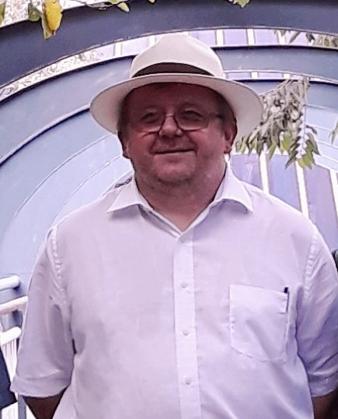
With Fr. Jan Stefanow, SVD
At the Service of
the CBF-SEA

Slide 15
At your Service
Sub regional Secretary
Sub regional Coordinator
Dr. Natividad B. Pagadut Sr. Marianne Gorit, OSB

Slide 16
Fr. Joseph Tai
the zonal representative for:
Vietnam
Thailand
Laos
Cambodia
Myanmar

Slide 17
Fr. Johannes Subagyo
the zonal representative for
Malaysia
Indonesia
Singapore

Slide 18
Fr. Arlo Yap, SVD
The zonal representative for the Philippines

Slide 19
From Left in 2018 Fr. Joseph Mary Tran, SDB Fr. Johannes Subagyo Fr. Jan Stefanow, SVD Fr. Arlo Yap, SVD Dr. Natividad B. Pagadut Sr. Marianne Gorit, OSB

Slide 20
Consultors 1. Bp. Pablo Virgilio David 2. Bp. Francis Xavier Vira

Slide 21
“The Bible and Life: The Biblical Inspiration of the Entire Pastoral Life and Mission of the Church (VD 73) Experiences and Challenges”

Slide 22
FORMATION ACTIVITIES

Slide 23
CBF-SEA Workshop in 2017
Nha Trang, Vietnam
July 17-23, 2017
Theme:
Transforming the family through the power of the Word
“Today salvation has come to this house”
(Luke 19:9)

Slide 24
* evangelization * formation * membership expansion * translation * publication
Area Action Plan Workshop

Slide 25
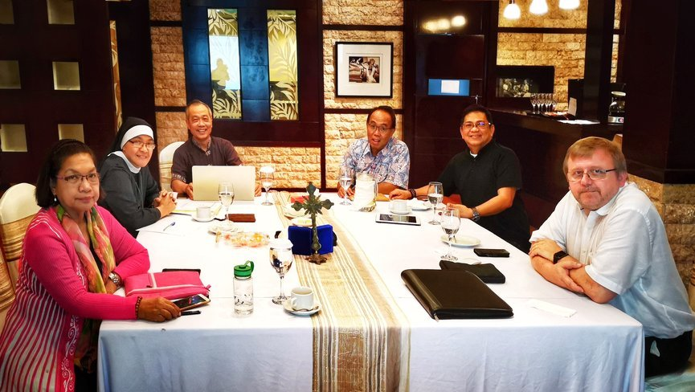
Meeting in Indonesia, July 5, 2018

Slide 26
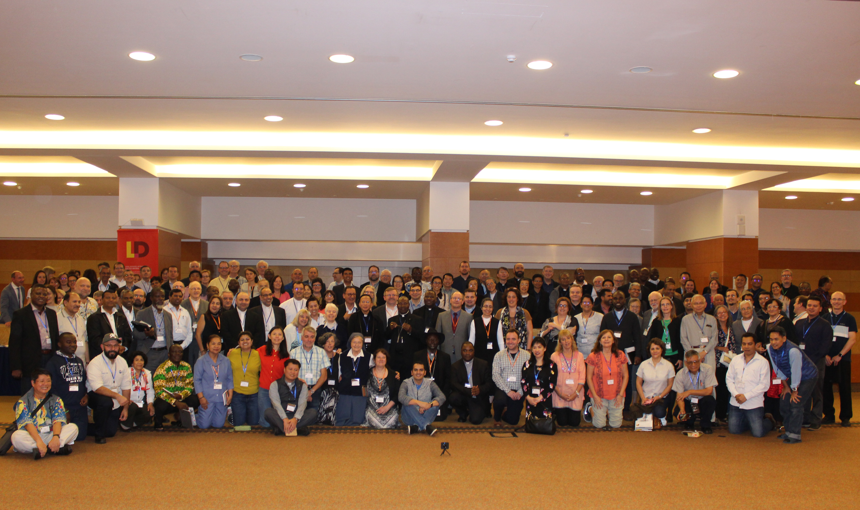
Participating in the International Pastoral Biblical Congress, April 23-26, 2019

Slide 27
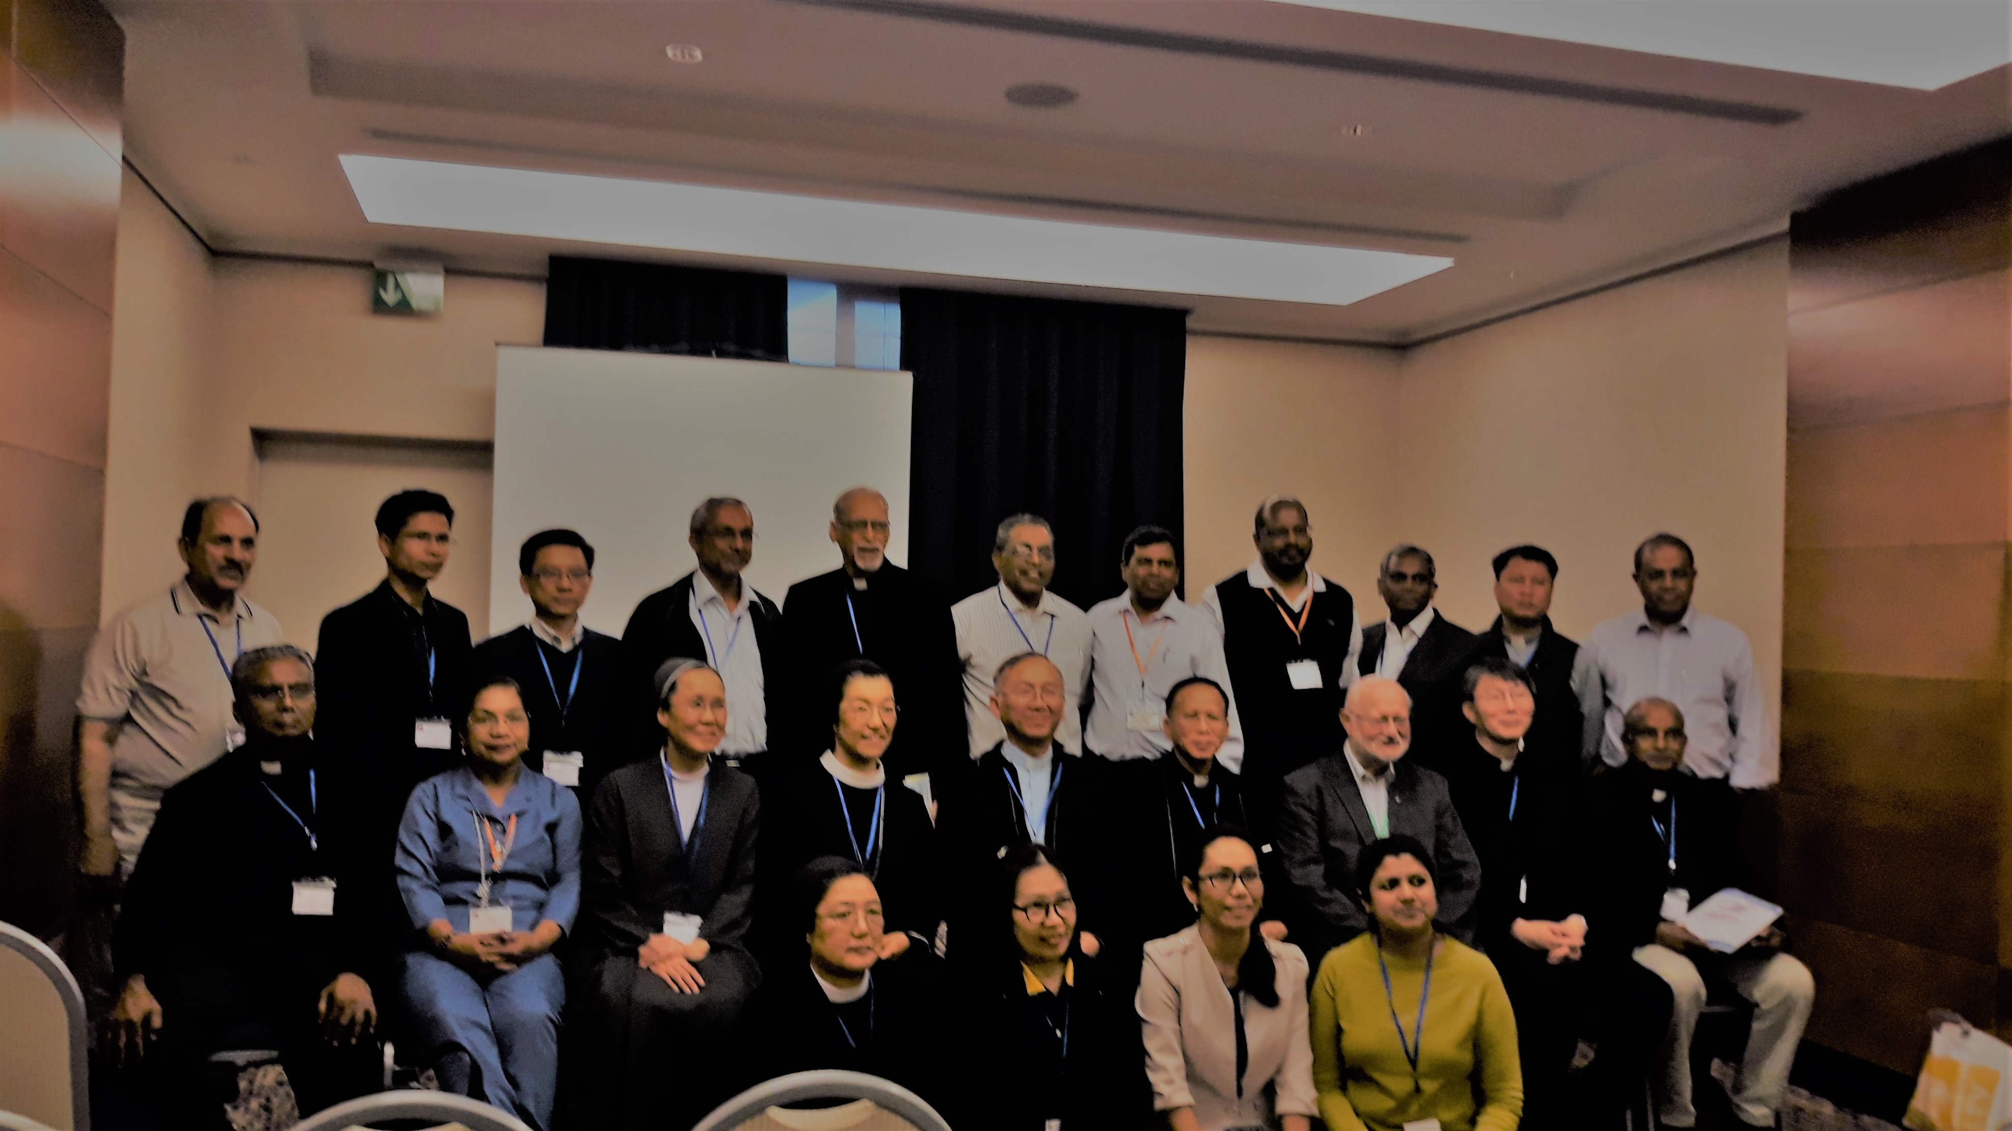
CBF-SEA and South ASIA Participants in the International pastoral Biblical Congress, April 23-26, 2019 in Rome

Slide 28
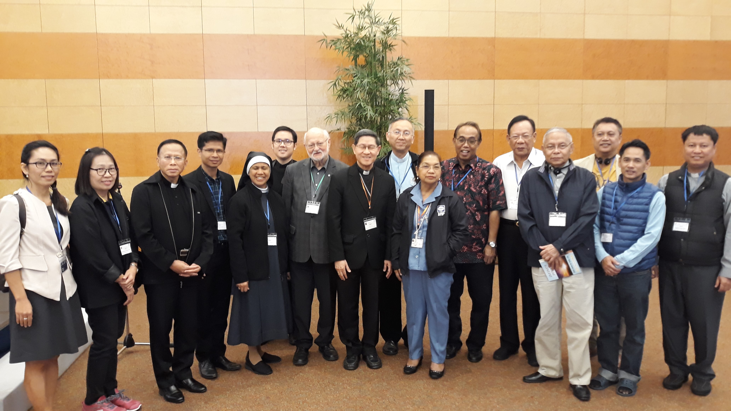
CBF-SEA Participants with CBF President Luis Antonio Cardinal Tagle

Slide 29
Tagaytay Gathering

Slide 30
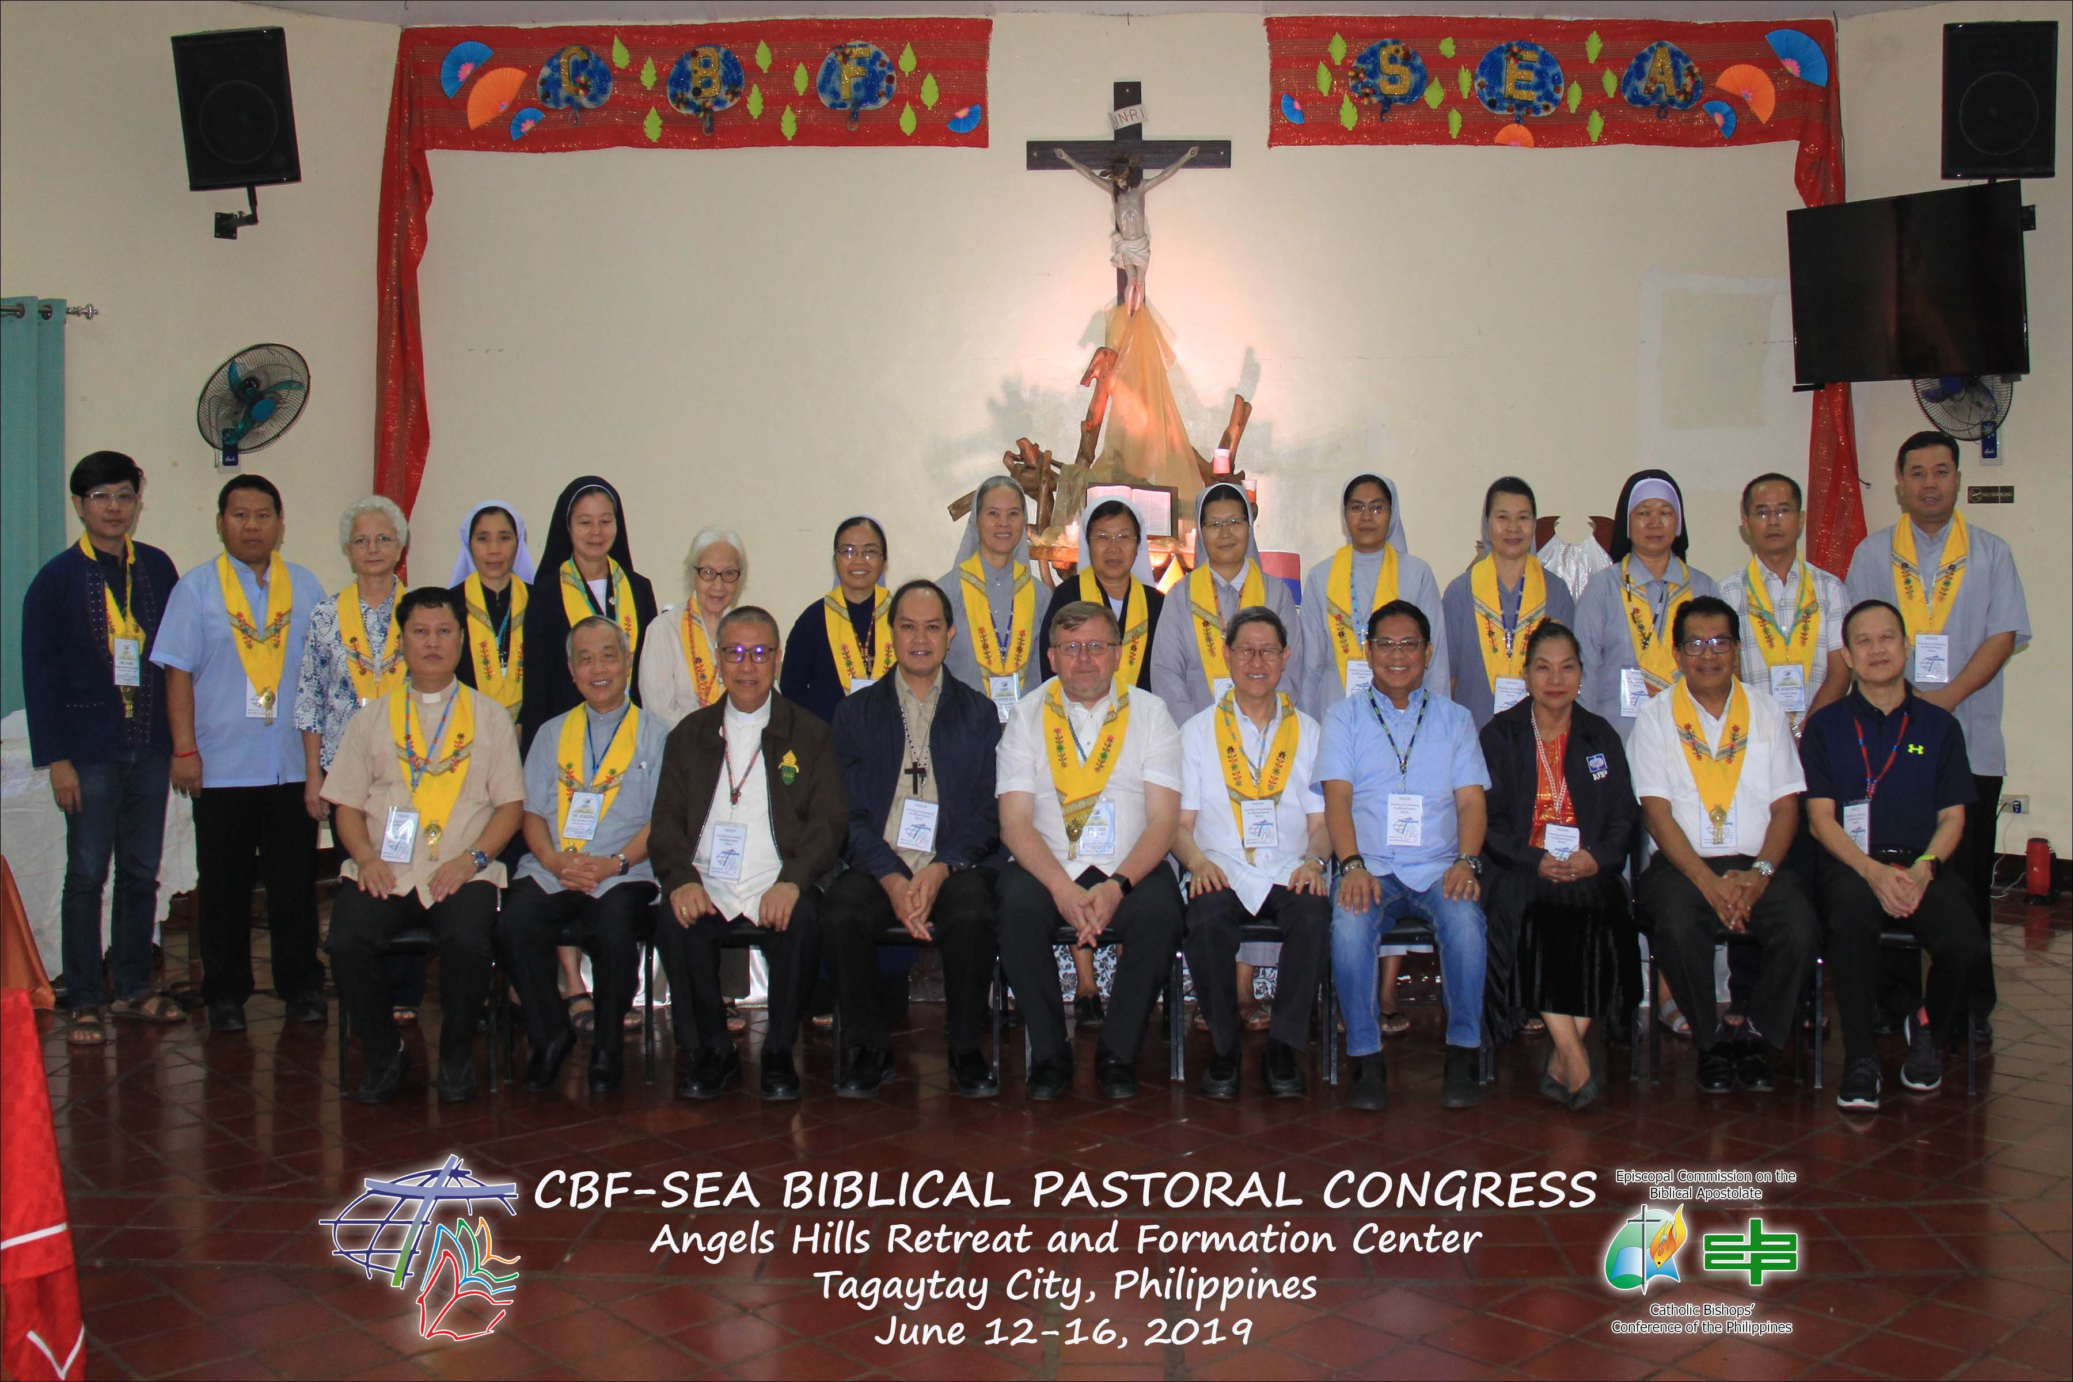

Slide 31
With His Eminence Luis Antonio Cardinal Tagle in a Webinar

Slide 32
Meetings
* CBF-SEA Online Meeting (ZOOM)
August 5, 2019 at 3;30 p.m. Philippine time – on details of the proposed workshop in Thailand on September 21-25, 2020
* Online Meeting on September 11, 2019 at 3:30 PM – follow up meeting on the theme, accommodation fees, etc.
* Face to face meeting – Fr. Alex Gobrin, Sr. Marianne Gorit, Dr. Nati – on the final program

Slide 33
CBF South-East Asia Committee Meeting
June 23, 2020 via Zoom platform – Presentation of the final plans/ program for a CBF-SEA Workshop in Thailand –
June 30, 2020
CBF-SEA Committee Meeting via Zoom Platform - > 2020 is the Year of the Word (CBF) – Preparation for the teleconference by His Eminence Luis Antonio Cardinal Tagle scheduled in September but was postponed to October due to health reasons

Slide 34
Prayer Meetings

Slide 36
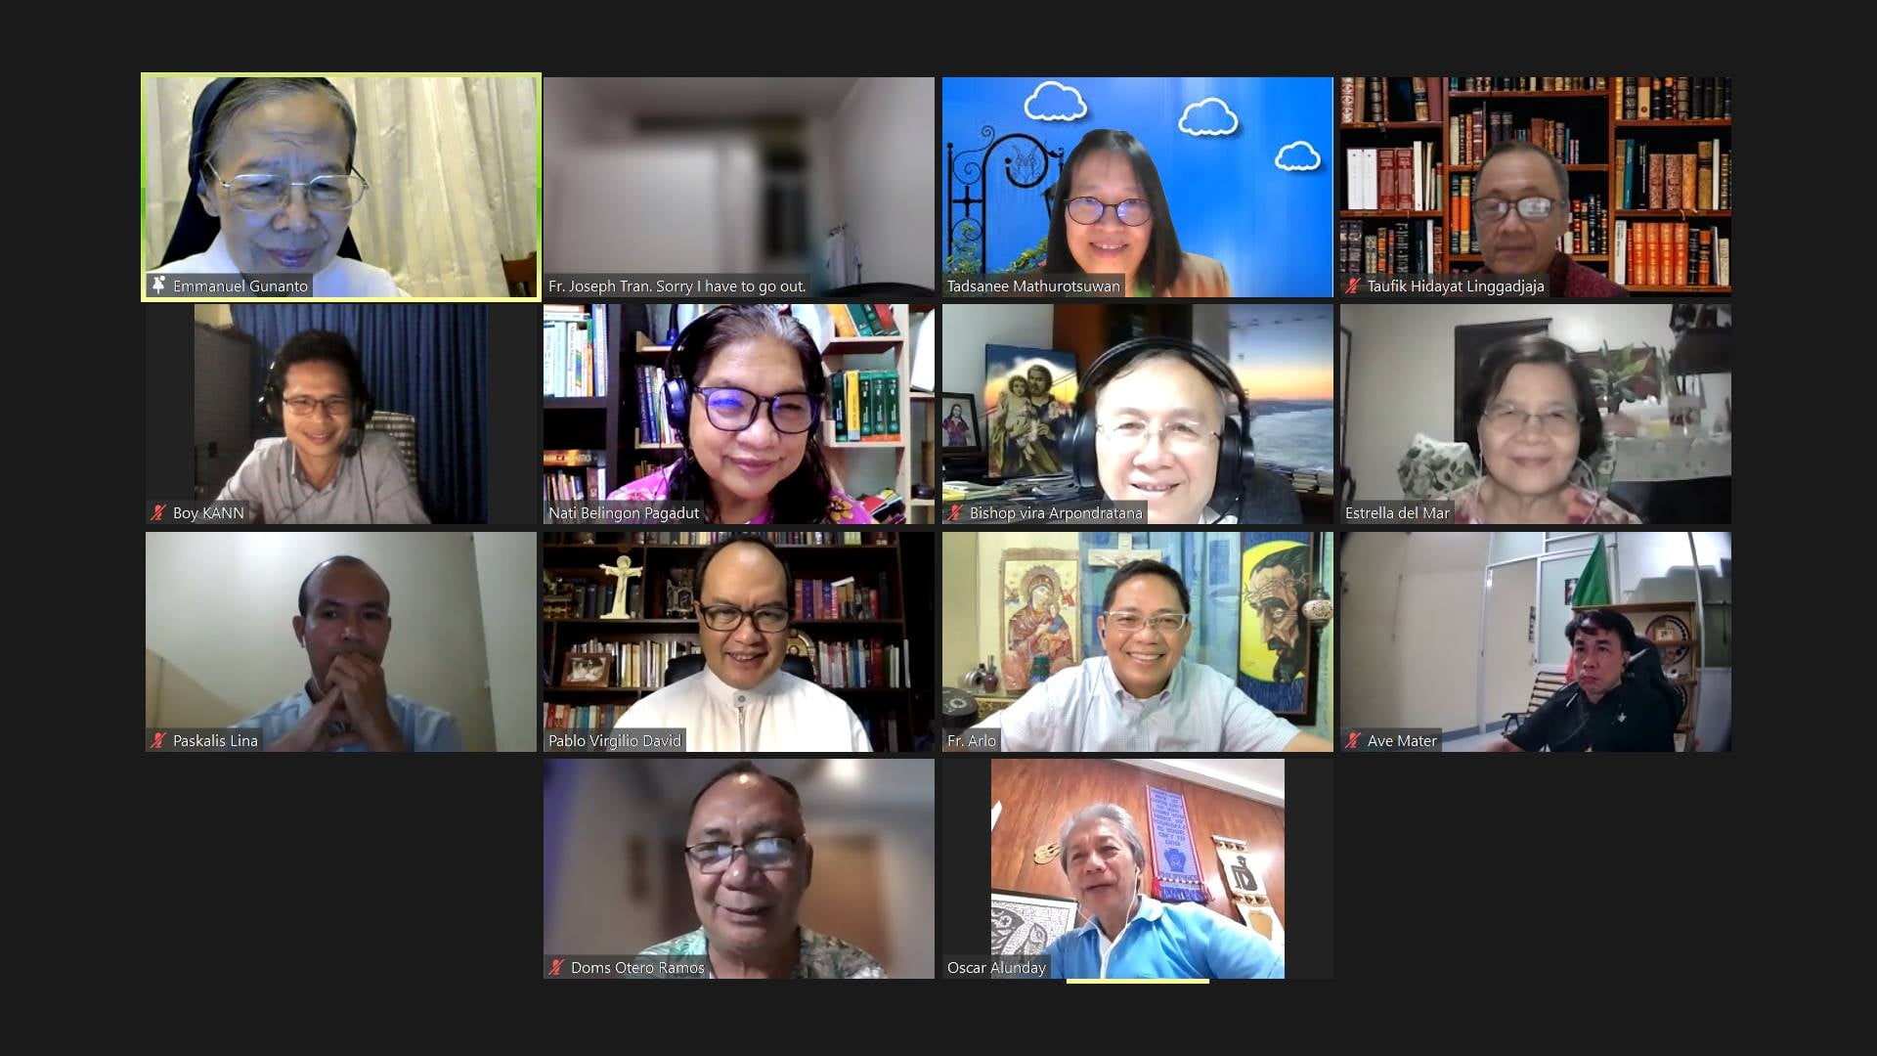
Virtual Visit

Slide 37
1. Lectio Divina 2. Formation Courses 3. Formation Seminars 4. Retreats and Recollections 5. Celebration of Bible Week/ Month
Popular Formation Activities in South East Asia

Slide 38
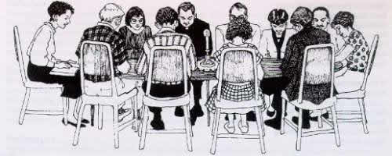
Lectio Divina remains to be one of the sub-region’s ongoing activity of the maturity of an ecclesial community. (VD 95)

Slide 39
6. The Bible in a Hundred Weeks” A three year bible course from Genesis to Revelation. 7. Biblical animation for a group in the Parish, (a Community of Contemplative Carmelite Sisters, a group of blind people, two groups of Prisoners). .

Slide 40
.
8. Story Telling as a Method for teaching the Bible to Children and Adults ---
9. A seminar with training for teachers and parents 10. Recollections for Bible Facilitators 11. Training for Bible Teachers
12. Bibliodrama
13. Bible Courses for Lay Leaders, and Members

Slide 41
During this pandemic, virtual masses, recollections, Bible sessions, visitations, prayer sessions, Bible webinars are subscribed to by those who are internet literate.

Slide 42
…..You will have trouble in the world; but, courage! I have overcome the world.“ Jn 16:33

Slide 43
Identified Challenges

Slide 44
1. Need for more sensitivity and deeper commitment of Bible personnel, leaders and workers to help one another with chores related to the mission of the CBF-SEA
2. Need for all Bible Leaders to learn how to use modern means of communication for better access to one another

Slide 45
Challenges
3. Need for more guides, materials for the use of BA lay leaders
4. More active participation from our BA member bishops, some regional directors, diocesan directors and parish priests.

Slide 46
Challenges
5. More collaboration with other commissions, congregations, partners in the apostolate
6. Financial assistance for Bible Apostolate projects

Slide 47
Challenges
7. More translations of the Bible in the different languages
8. Adequate training of translators
9. Familiarity, training and creative use of modern ways of communication by all for all.

Slide 48
Communication Channels

Slide 49
To God be the Glory
Amen.

